Slide 1

Deep Learning Portfolio
A Comprehensive Review of Coursework, Labs, and Projects
Course: ITAI-2376
TEAM MEMBERS
Richard Evans
Nezar Khalfallah
Sufyan Rafiq
Hayden Wood
https://github.com/DrahcirSnave/Capstone_Research_Assistant_Agent
https://github.com/DrahcirSnave/Predictive-Maintenance-Capstone-2025

Slide 2
Course Objectives and Scope
The primary objective of this course was to bridge the gap between theoretical machine learning concepts and practical, production-ready AI implementation. The curriculum was designed to provide a complete lifecycle understanding of Deep Learning, beginning with the fundamental mathematics of tensors and backpropagation and advancing to complex architectures like Diffusion models and Transformers. A significant focus was placed on mastering the "Neural Network Zoo"—understanding the distinct roles of Convolutional Neural Networks (CNNs) for computer vision versus Recurrent Neural Networks (RNNs) and Transformers for sequential data. Furthermore, the course aimed to develop proficiency in the industry’s two dominant frameworks, TensorFlow and PyTorch, ensuring the ability to not only build models but to deploy them effectively in scalable environments.
Learning Perspective
The From a learner's perspective, the journey began by demystifying the "black box" of AI. We deconstructed neural networks into their "Magical Trio"—Weights, Bias, and Activation Functions—to understand exactly how machines make decisions. Through hands-on laboratories, we moved beyond simple theory to implementation. We built CNNs from scratch to classify MNIST digits, witnessing how deep layers extract features hierarchically, from simple edges to complex shapes.
We also tackled the nuanced challenges of Natural Language Processing (NLP). By analyzing linguistics through the lens of the film Arrival, we learned that language is context-dependent and non-linear, requiring rigorous preprocessing techniques like tokenization and lemmatization. Crucially, the coursework emphasized that "training" is only half the battle; we spent significant effort on model optimization, learning to diagnose underfitting versus overfitting and utilizing advanced hyperparameter tuning methods like Grid and Randomized Search to find the "Goldilocks" zone of model performance.

Slide 3
Real-World Takeaways and Future Application
As we prepare to apply these skills in the real world, the key takeaway is the ability to select the right tool for the specific problem. We now possess the discernment to choose TensorFlow for scalable, mobile, or IoT production environments versus PyTorch for rapid research and prototyping. We learned that efficiency often trumps novelty; our work with Transfer Learning (using VGG16) proved that leveraging pre-trained models is often more effective than training from scratch. Finally, our capstone work with Generative AI and autonomous Research Assistants using LangChain demonstrates that we are ready for the next frontier of AI: moving beyond static models to building functional, agentic workflows that can autonomously synthesize information and solve complex tasks.

Slide 4


Machine Learning Fundamentals
Training vs. Validation
The model learns from the training set, while the validation set is used to tune hyperparameters and check for generalization.
Fitting the Model
•
Underfitting (High Bias): Model is too simple; fails to capture patterns.
•
Overfitting (High Variance): Model is too complex; memorizes noise instead of data.
Notes:
The fundamental definitions and processes in machine learning, emphasizing the necessity of partitioning data into training (70-80%) and validation (10-15%) sets to ensure generalization. It defines critical model states, distinguishing between "underfitting," where a model is too simple to learn patterns, and "overfitting," where a model is too complex and captures noise. The document also differentiates between classification and regression tasks and explains key evaluation metrics, including the confusion matrix, accuracy, and recall, which are vital for assessing model performance on unbalanced datasets.

Slide 5






Neural Networks: The Magical Trio
Weights
Bias
Activation Function
"The Importance Knobs" Determines how much influence a specific input (like a pixel) has on the output.
"The Starting Point Boost" Allows the model to shift the activation function, ensuring a neuron can fire even with zero inputs.
"The Go/No-Go Switch" Introduces non-linearity (e.g., ReLU), deciding if a neuron should pass the signal forward.
Notes:
The magical flow:
A neuron in a deep learning model receives some information.
2. It uses weights to figure out how important each piece of information is.
3. It adds a bias to give the decision a little nudge.
4. It puts all those numbers into a calculator and gets a final result.
5. It sends that final number to the activation function, which acts as a switch to make the final "go/no-go" decision.
This process happens billions of times, with each neuron in the network adjusting its weights and bias a tiny bit every time it makes a mistake. This is how the computer learns and gets better at its tasks over time! The three magical ingredients—weights, bias, and activation functions—work together to make the magic of deep learning happen.

Slide 6
Frameworks: PyTorch vs TensorFlow
Feature | PyTorch (Meta AI) | TensorFlow (Google Brain)
Graph Type | Dynamic (Define-by-Run) | Static (Historically), now Eager Mode
Strengths | Research flexibility, debugging, Pythonic nature | Scalability, production deployment (TF Serving)
Industry Use | Tesla Autopilot, Hugging Face, OpenAI | Google Translate, Airbnb, Uber
Verdict | Preferred for rapid prototyping and research | Preferred for large-scale industrial pipelines
Notes:
The foundational introduction to TensorFlow, focused on the manipulation of tensors, the core data structure of deep learning. The notebook covers essential operations such as creating constant and variable tensors, performing mathematical operations (addition, multiplication), and reshaping data dimensions. It concludes with a basic implementation of a linear regression model, demonstrating how TensorFlow computes gradients and optimizes variables to fit a simple line ($y = mx + b$) to a dataset.

Slide 7
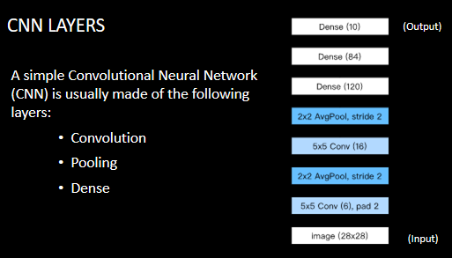
CNN Architecture
Convolutional Neural Networks
Designed specifically to process pixel data for image recognition tasks.
Key Layers Used
•
Conv2D: Uses filters (kernels) to detect features like edges and curves.
•
MaxPooling2D: Reduces spatial dimensions, making the model robust to small shifts/distortions.
•
Dropout: Randomly ignores neurons during training to prevent overfitting.
•
Flatten & Dense: Converts 2D maps to 1D vectors for final classification.
Notes:
The practical implementation of a Convolutional Neural Network (CNN) designed to classify handwritten digits from the MNIST dataset. The workflow begins with essential preprocessing steps, including normalizing pixel values to a 0-1 range and reshaping the data to include a channel dimension necessary for Keras layers. The model architecture was constructed using a sequential approach, stacking Conv2D layers for feature detection and MaxPooling2D layers to reduce spatial dimensions, before transitioning to a Flatten layer and fully connected Dense layers.

Slide 8
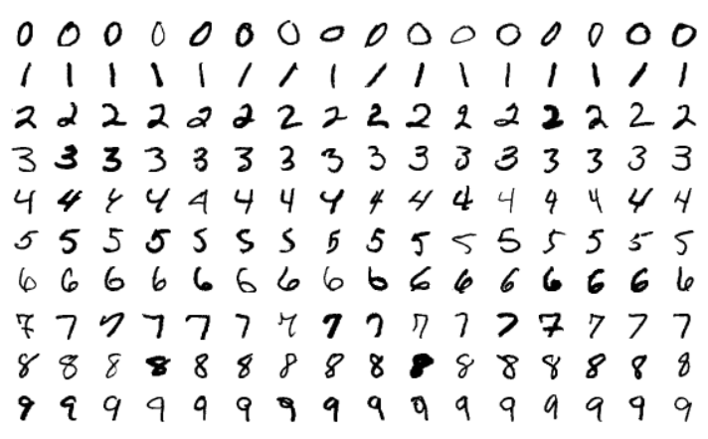
MNIST Classification
Project Outcomes
Successfully trained a CNN to classify handwritten digits (0-9) from the MNIST dataset with high accuracy.
Reflective Insights
•
Feature Hierarchies: Learned how small filters combine to detect complex shapes.
•
Parameter Tuning: Experimented with filter sizes (32 vs 64) and dropout rates to balance speed and accuracy.
•
Real-World Context: Understood why CNNs are superior to standard dense networks for visual tasks (spatial invariance).
Notes:
The practical implementation of a Convolutional Neural Network (CNN) designed to classify handwritten digits from the MNIST dataset. The workflow began with essential preprocessing steps, including normalizing pixel values to a 0-1 range and reshaping the data to include a channel dimension necessary for Keras layers. The model architecture was constructed using a sequential approach, stacking Conv2D layers for feature detection and MaxPooling2D layers to reduce spatial dimensions, before transitioning to a Flatten layer and fully connected Dense layers.

Slide 9

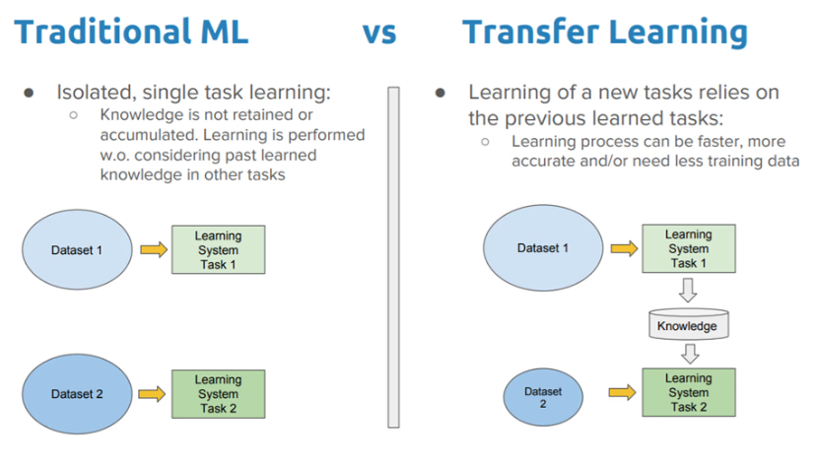
Transfer Learning
Using Pre-trained Models
We leveraged VGG16, a powerful model trained on the massive ImageNet dataset, to classify new images without starting from scratch.
Key Lessons
•
Efficiency: Using pre-trained weights saves immense computational time and data requirements.
•
Preprocessing: Images must be preprocessed (resized, normalized) exactly as the original model expects to get accurate results.
•
Sensitivity: Even slight rotations or noise can drastically change a model's prediction confidence.
Notes:
Analogy of the Core Concept Transfer Learning:
Think of it like learning to play a musical instrument.
From Scratch: If you have never played music before, learning the electric guitar is hard. You have to learn rhythm, how to read notes, and hand coordination all at once.
Transfer Learning: If you already know how to play the piano, learning the electric guitar is much easier. You don't need to relearn rhythm or music theory; you transfer that general knowledge and only focus on the specific mechanics of the new instrument.
Main Approaches
Inductive Transfer: The source and target tasks are different, but the domains are related. (e.g., A model trained to identify animals is adapted to identify cancer cells in X-rays).
Transductive Transfer: The task is the same, but the domain (environment) is different. (e.g., An autonomous car trained on sunny California roads needs to adapt to driving in snowy Norway).

Slide 10




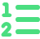

Neural Networks
CNN (The Cheetah)
RNN (The Memory Keeper)
Transformer (The All-Rounder)
Fast and sharp-eyed. Ideal for image processing, grids, and local feature extraction. Best at "seeing".
Processes sequences sequentially. Good for time series but struggles with long-term memory.
Uses Self-Attention to understand global context and parallel processing. The engine behind modern NLP and LLMs.
Notes:
Neural networks are computer systems inspired by the way the human brain works. Just like our brains use billions of neurons to process information, a neural network uses small “artificial neurons” connected together to recognize patterns and make decisions.
These networks are organized in layers: an input layer (where data enters), one or more hidden layers (where the system processes and learns patterns), and an output layer (where the final decision or prediction is made).
Deep learning is simply when a neural network has many of these hidden layers stacked together. With more layers, the system can learn very complex patterns—like understanding speech, identifying objects in pictures, or even powering self-driving cars.

Slide 11
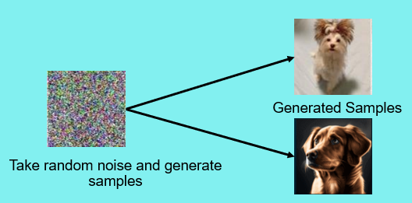
Diffusion Models
Creating Images from Noise
Built a diffusion model to generate realistic handwritten digits from pure random noise.
How it Works
•
Forward Process: Gradually add noise to an image until it destroys all information.
•
Reverse Process: Train a U-Net neural network to predict and remove the noise step-by-step, restoring the image.
•
Result: An AI that can "draw" new, unique digits that never existed before.
Notes:
The team developed a deep Convolutional Neural Network (CNN) to classify images from the complex CIFAR-10 dataset. The workflow incorporated robust data augmentation techniques, such as random horizontal flips, rotations, and zooms, to prevent overfitting and improve generalization
The architecture featured multiple stacks of Conv2D and MaxPooling2D layers, utilizing ReLU activation and Padding to preserve spatial dimensions
2. The model's training progress was monitored via accuracy and loss plots, demonstrating the effectiveness of data augmentation in stabilizing validation performance.

Slide 12
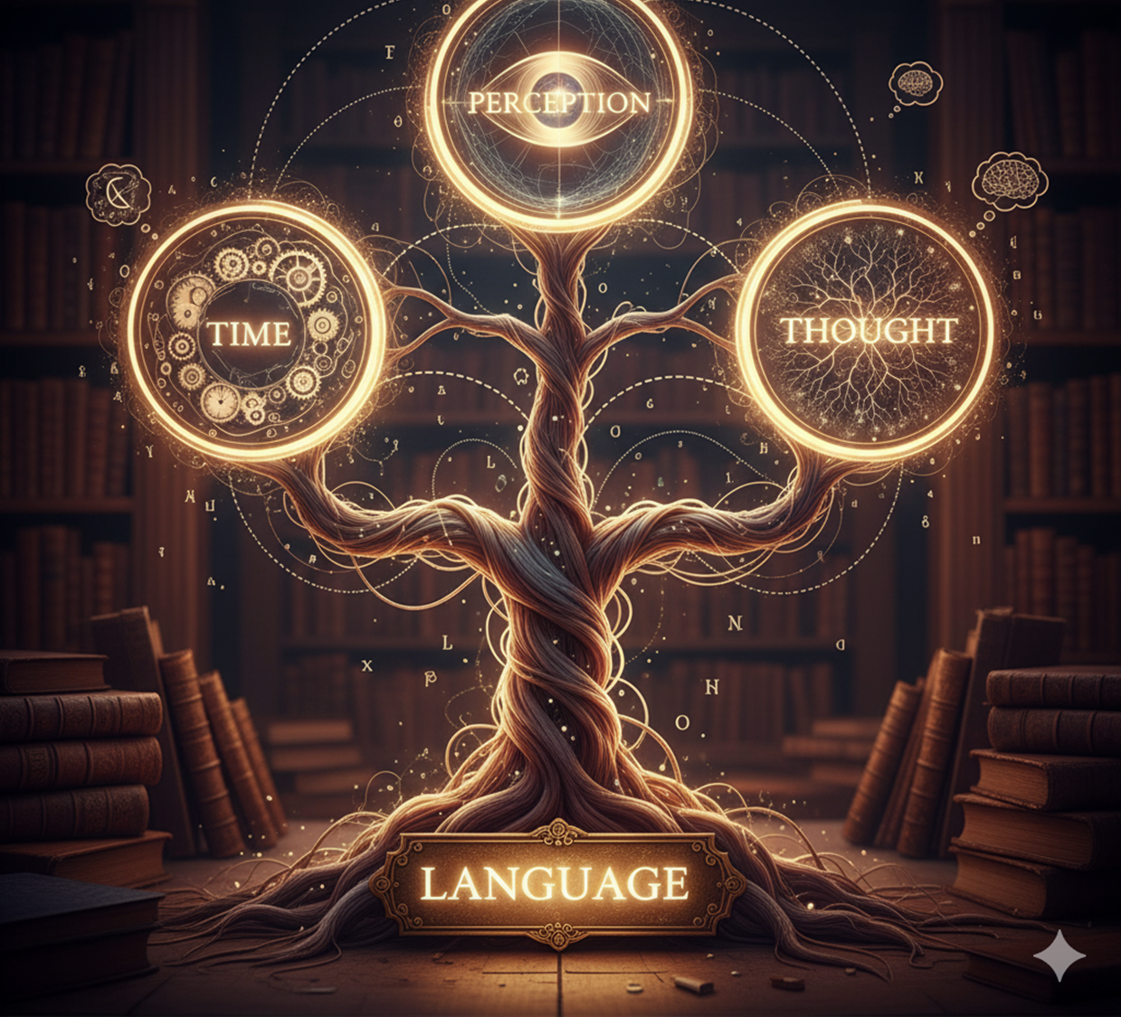
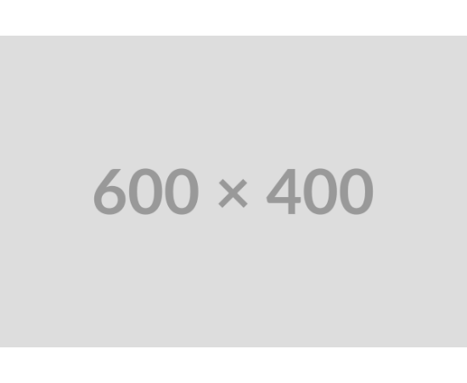
NLP Insights from "Arrival"
Language is Non-Linear
Analyzed the film "Arrival" to understand the complexity of linguistics in AI.
NLP Challenges Identified
•
Ambiguity: Words like "Purpose" can mean intent or object. AI needs context to disambiguate.
•
Preprocessing: Louise's work mirrors NLP steps: Tokenization (breaking down symbols) and Lemmatization (finding root meanings).
•
Sapir-Whorf Hypothesis: The idea that language shapes thought—similar to how model architecture constrains what an AI can "think" or represent.
Notes:
Arrival shows that understanding language requires more than processing symbols; it demands empathy, context, and perspective. The protagonist (Louise’s) journey demonstrates that meaning is built through connection, not translation alone. Similarly, the next generation of NLP must integrate cultural awareness, emotional understanding, and context sensitivity. The future of language technology lies in collaboration between humans and machines that can interpret meaning as Louise did — with insight and compassion.
In the movie the protagonist is essentially “preprocessing” the sentence. She strips each word down to its root meaning (lemmatization), identifies context and relationships (vectorization), and reconstructs the question in a form the heptapods can comprehend. This mirrors how NLP pipelines prepare text for deeper analysis.
Breaking down “purpose” – She asks: How do we define purpose? Is it “reason,” “intention,” “goal,” or “mission”? (Lemmatization)
Clarifying “your” – Who does “your” refer to? A single heptapod? Their species? Their civilization? (Disambiguation (contextual vectorization)
Interpreting “on Earth” – Does “Earth” mean the physical planet, humanity, or a metaphorical space? (Tokenization & semantic mapping)
Question structure – “What is…” presumes they understand interrogatives, but what if their language lacks questions? (Syntactic parsing)

Slide 13


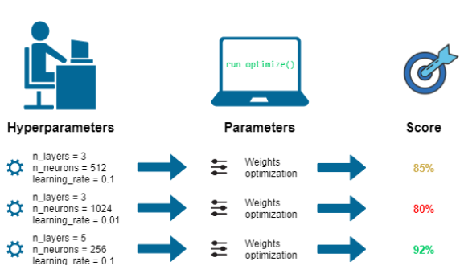

Hyperparameter Tuning with Keras Tuner
Fine-Tuning the Engine
Explored strategies to maximize model performance beyond the initial training.
Techniques Used
•
Grid Search: Exhaustively testing all parameter combinations (thorough but slow).
•
Randomized Search: Sampling random combinations (faster, often just as effective).
•
Validation Curves: Visualizing the trade-off between Bias and Variance to find the "Goldilocks" zone.
Notes:
We created a notebook that demonstrates the optimization of a neural network using the Keras Tuner library to automate the selection of hyperparameters. The process involved defining a model-building function that dynamically adjusts parameters such as the number of units in dense layers (ranging from 32 to 512) and the learning rate (testing values like 1e-2, 1e-3, and 1e-4). Using the RandomSearch tuner, the team searched for the best configuration to minimize validation loss over multiple trials. The results highlighted the optimal combination of hyperparameters, significantly improving model performance compared to manual guessing.

Slide 14








Comprehensive Takeaways
Foundations
Generative AI
NLP & Context
Mastered the core "Magical Trio" (Weights, Bias, Activation) and the architecture of CNNs.
Moved beyond classification to generation, understanding the U-Net and Diffusion processes.
Learned that language is complex and context-dependent, requiring advanced architectures like Transformers.
Practical Ops
Gained skills in Transfer Learning (VGG16) and Hyperparameter Tuning to build efficient, production-ready models.

Slide 15
Conclusion
In conclusion, this Capstone portfolio documents a transformative progression from mastering the fundamental building blocks of neural networks to engineering sophisticated, production-ready AI systems. By rigorously applying theory through hands-on experimentation—whether optimizing Convolutional Neural Networks for computer vision, fine-tuning hyperparameters for model stability, or architecting autonomous agents with Large Language Models—We have developed a robust technical foundation grounded in industry standards. This journey has moved beyond simple code execution to a deep, intuitive understanding of why models behave as they do, equipping us with the critical thinking skills necessary to navigate the complexities of modern AI. As the field rapidly evolves towards Generative AI and agentic workflows, the skills evidenced in this body of work demonstrate not just technical competence, but a readiness to drive innovation and solve complex, real-world problems in the dynamic landscape of Artificial Intelligence.
Notes:
.

